Slide 1
Introduction
Ying shen
School of software engineering
Tongji university

Slide 2
Course Title
Human-Computer Interaction

Slide 3
Lecturer
Ying Shen
Room: 509, Jishi Building
E-mail: yingshen@tongji.edu.cn
TA: TBA

Slide 4
Lecture Hours
8:00-11:40 am Friday

Slide 5
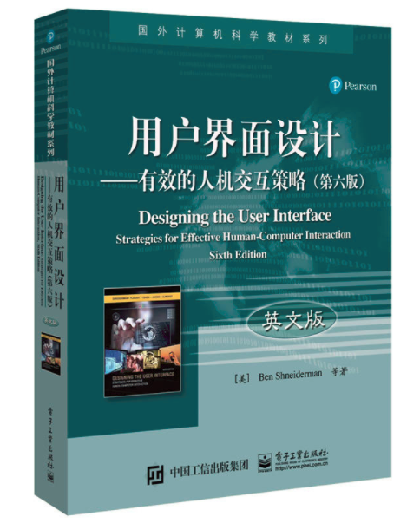
References
Designing the User Interface: Strategies for Effective Human-Computer Interaction, Six Edition
Chapter 4, 5, 7, 8, 9, 10, 15, 16

Slide 6
Assessment
Project 60%
Assignment 30%
Participation 10%
Course Web Page
http://sse.tongji.edu.cn/~yingshen/HCI2021Spring/index.html

Slide 7
What is Human-Computer Interaction?
Human
Computer
Interface

Slide 8
Human-Computer Interaction
HCI: a discipline concerned with the design, evaluation and implementation of interactive computing systems for human use and with the study of major phenomena surrounding them (ACM SIGCHI, 2014)
The study of how people design, implement and use interactive computer systems.
The study of how computers affect individuals, organizations, and society.
Notes:
1.用户界面设计，多媒体交互技术
2.计算机对人的影响，摇一摇，facebook，instagram，apple watch

Slide 9
Requirements of HCI
Ease of use
GUI vs command language
Online help, documentation and training
More powerful forms of communications between users and computers
New interaction techniques
New input and output devices
Notes:
最好不需要或者需要简单的training
data glove，google glass
kinect，全息投影
3d打印 vlog

Slide 10
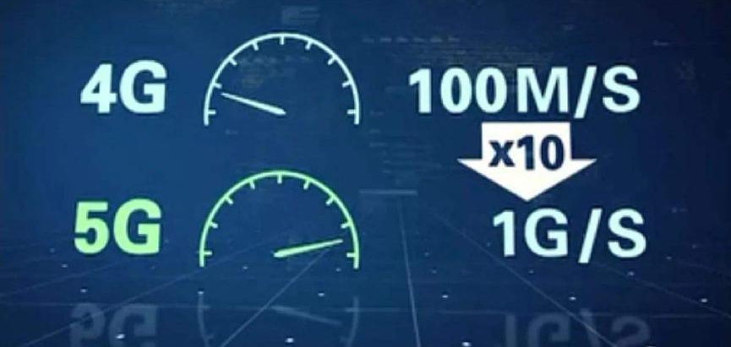
Requirements of HCI (cont’d)
Universal access to information
Proliferation of WWW (5G)
Information-access interfaces
Must be able to deal with new kinds of data, e.g., multimedia information.
Permit new kinds of interaction.
Require collaborations between HCI and database research communities.
Notes:
Smart phone
Facebook wiki youtube twitter instagram

Slide 11
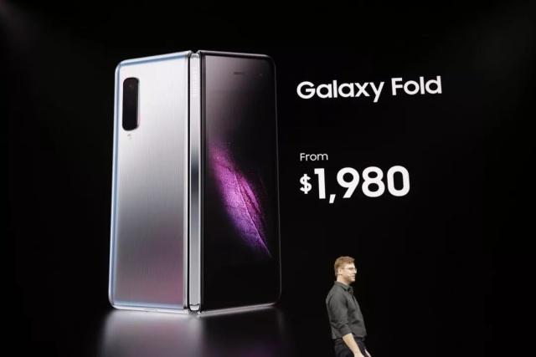
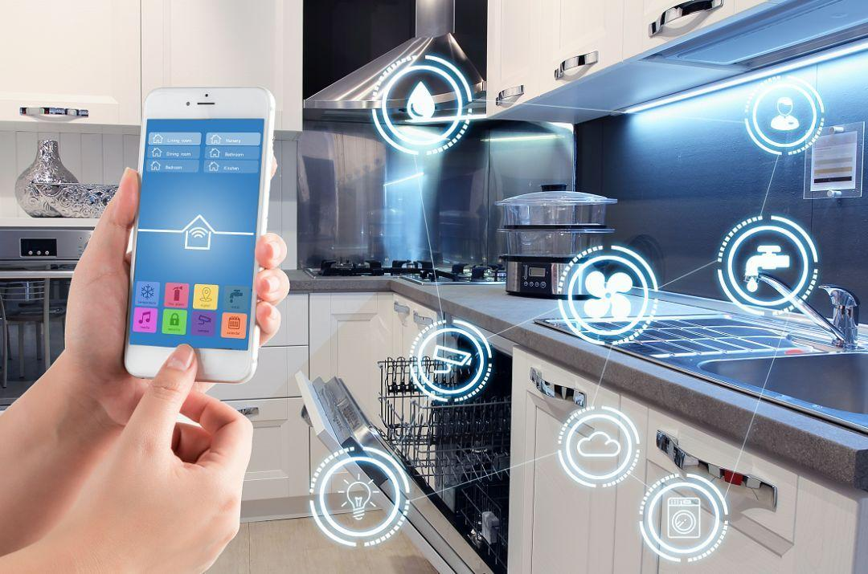
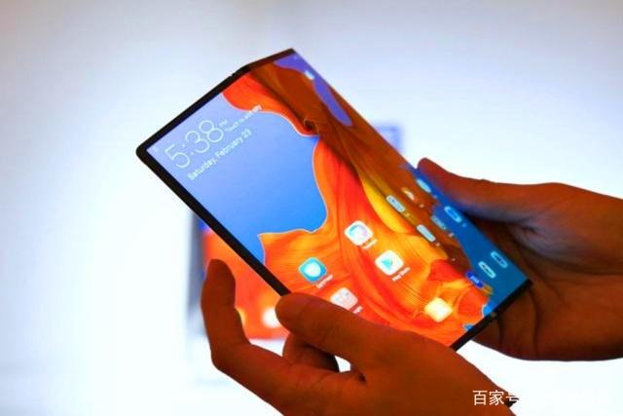
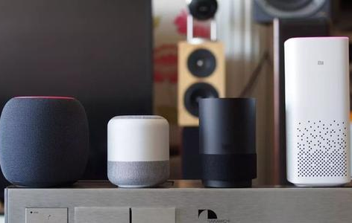
Importance of HCI
Good HCI design is critical to
Success of products in marketplace
Safety, usefulness and pleasure of using computer-based systems.
Poor HCI design have led to several well-known catastrophes.
Notes:
三里岛事故

Slide 12
Importance of HCI (cont’d)
Good HCI design can decrease costs and increase productivity due to
Fewer errors
Reduced user disruption
Decreased task time
Reduced burden on support staff
Elimination of training

Slide 13
Foundations of HCI
Computer science
Psychology
Sociology/anthropology
Linguistics
Artificial intelligence
Notes:
Linguistics：网络语言

Slide 14
History of HCI
Direct manipulation of graphical objects.
Windows
Hypertext
Notes:
https://www.sensomatic.com/chz/gui/history.html

Slide 15
Direct manipulation of graphical objects
First demonstrated by Ivan Sutherland in Sketchpad (1963)
Use light pen to manipulate objects.
Most of the direct manipulation techniques are developed in Xerox PARC in 1970’s.
“Direct Manipulation” was first coined by Ben Shneiderman (University of Maryland).
Notes:
https://www.youtube.com/watch?v=6orsmFndx_o
https://www.youtube.com/watch?v=M0zgj2p7Ww4&list=RDCMUCHDr4RtxwA1KqKGwxgdK4Vg&index=2 (Xerox PARC)
https://www.youtube.com/watch?v=Cn4vC80Pv6Q (Xerox PARC)

Slide 16
Windows
Tiled windows
First demonstrated by Engelbart.
Other systems: COPILOT, Emacs.
Overlapping windows
First proposed by Alan Kay
Used in the Smalltalk system (Xerox PARC)
Notes:
https://www.youtube.com/watch?v=B6rKUf9DWRI (Engelbart)
https://www.youtube.com/watch?v=NqKyHEJe9_w (Smalltalk)

Slide 17
Hypertext
Original idea is credited to Vannevar Bush (“As we may think”, 1945)
The term “hypertext” is first coined by Ted Nelson.
Ben Shneiderman’s Hyperties
First system where highlighted items in the text could be selected to go to other pages.
Apple Hypercard further popularizes the idea to a wide audience.
Tim Berners-Lee’s adoption of hypertext in browser leads to spectacular growth of the World Wide Web.
Notes:
https://www.youtube.com/watch?v=3Va3oY8pfSI (Hyperlink)

Slide 18
HCI in the future
Voice interaction
VR/AR
…

Slide 19
HCI Applications
Multimedia information retrieval.
Entertainment
Education
Interface for security enforcement
Information visualization
Computer-mediated communication

Slide 20
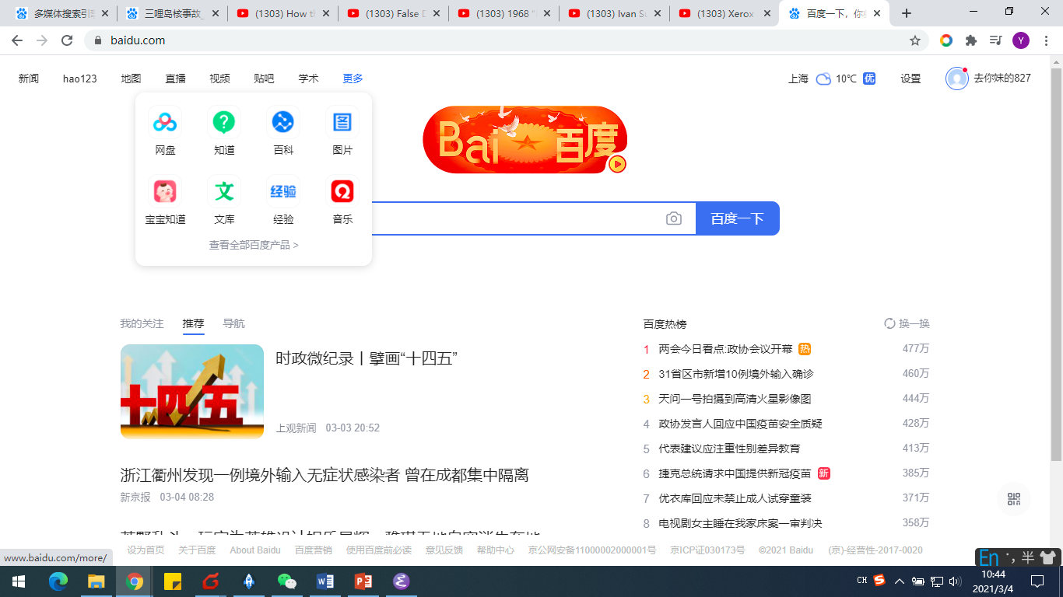
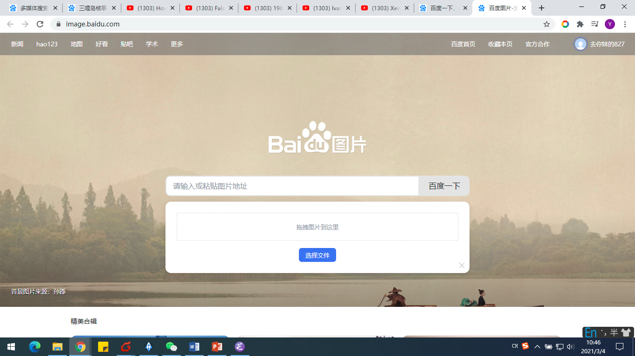
Multimedia Information Retrieval
In many cases, multimedia contents cannot be easily characterized by specific keywords.
Interfaces equipped with alternative querying mechanisms, such as example-based query specification, are required for effective retrieval.

Slide 21
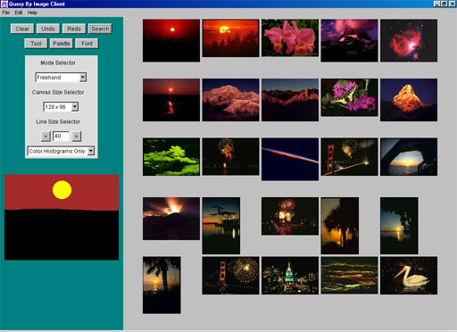
Multimedia Search Engine
Notes:
http://www.apimages.com/fronts/Default.aspx?sh=14

Slide 22
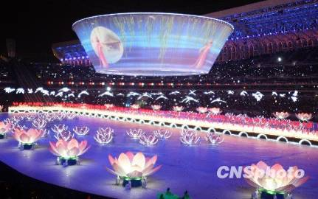
Entertainment
在北京08奥运会开幕式采用的高亮度数字投影设备和十一全运会开幕式投影系统采用的“大碗幕” 展示了现代投影技术的巨大创造力。

Slide 23
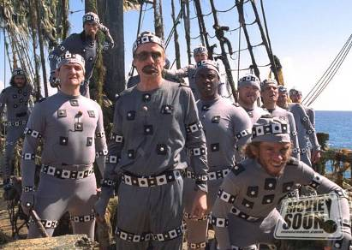
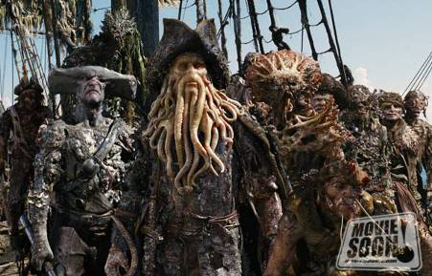
Entertainment
CG techniques in movies

Slide 24
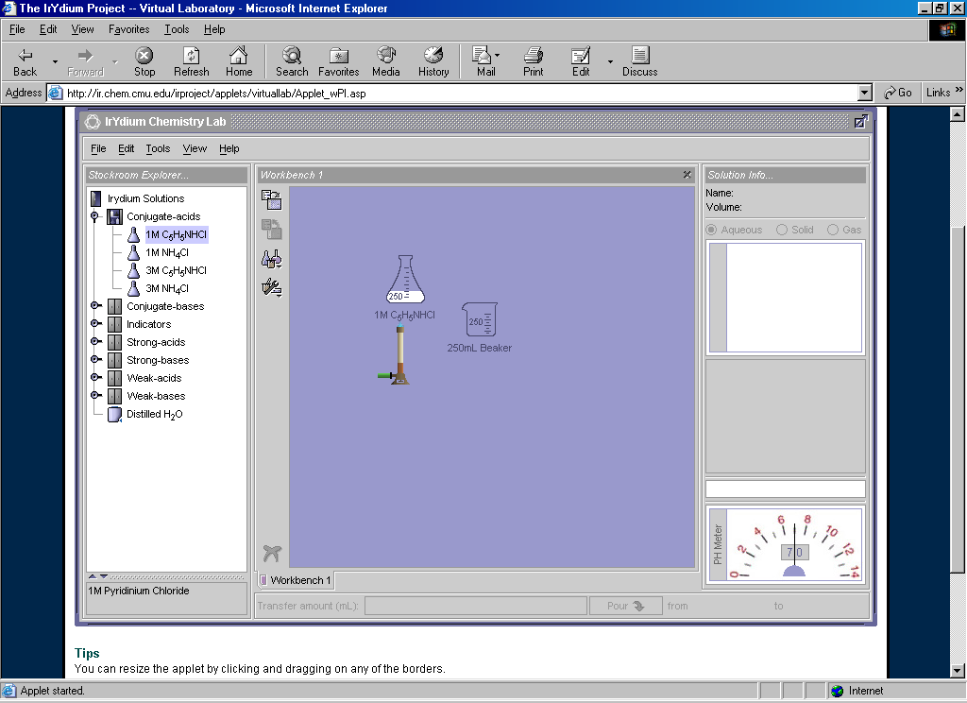
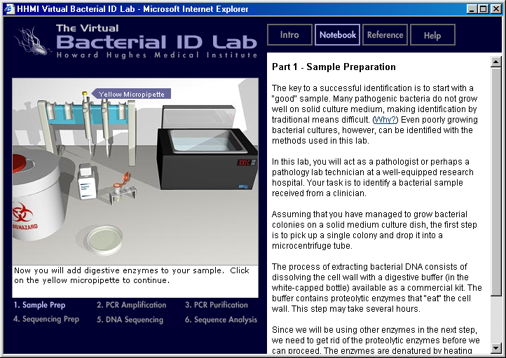
Education
Direct Manipulation Examples
Chemistry
Biology
Notes:
https://www.youtube.com/watch?v=CSyBXIK_XH0

Slide 25
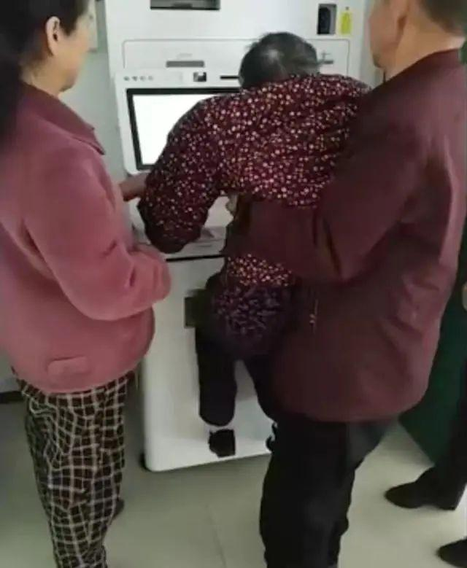

Interface for Security Enforcement
User authentication based on a set of biometric features:
Fingerprints
Iris
Speech patterns
Facial characteristics
Non-intrusive techniques are preferable to intrusive techniques.

Slide 26
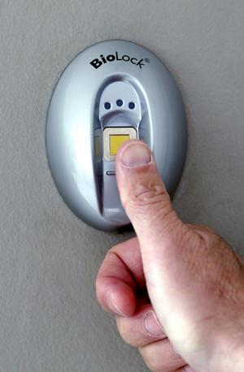
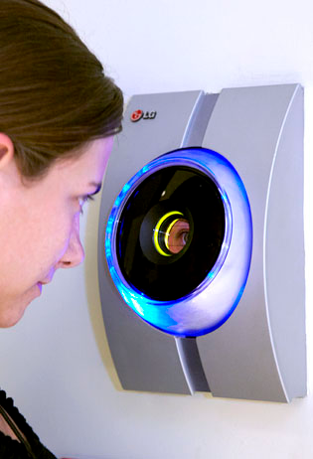
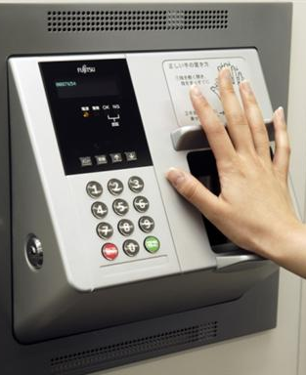
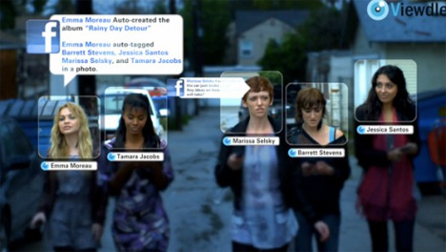
Interface for Security Enforcement

Slide 27
Information Visualization
Presentation of large data sets in a suitable graphical formats for trend exploration.
Becomes more important due to information explosion brought on by the Web.
Examples
Visualizing communication networks.
Example
Visualizing the Web itself
Example
Notes:
大数据电影票房预测
https://www.media.mit.edu/projects/income-race-bikes/overview/

Slide 28
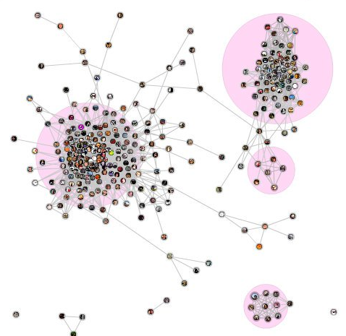
Visualizing Communication Networks
Notes:
Here's a visualization of the connections between my Facebook friends, which I created with the “social graph” Facebook application.

Slide 29
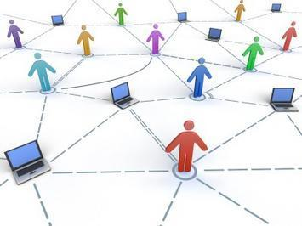
Computer-mediated Communication
Communication between human users through computers.
Examples include
E-mail
Real-time video and audio interactions
Notes:
qq, skype, gtalk

Slide 30
Technological Trends
Computational devices and ubiquitous computing.
Recognition-based user interfaces.
Conversational interface
3-D Technologies.
Virtual reality and augmented reality

Slide 31
Computational Devices and Ubiquitous Computing
New types of computational devices in addition to workstations and PC
Laptops
Mobile phones
Personal Digital Assistant (PDA)
Wearable computers and devices.
Ubiquitous computing
Embedding computers everywhere in our environment.
Example: MIT’s Things That Think (TTT) project
Notes:
pda: mobile device that functions as a personal information manager.
PDAs were discontinued in early 2010s after the widespread adoption of smartphones
ubiquitous computing can occur using any device, in any location, and in any format.
https://www.media.mit.edu/projects/mod/overview/

Slide 32
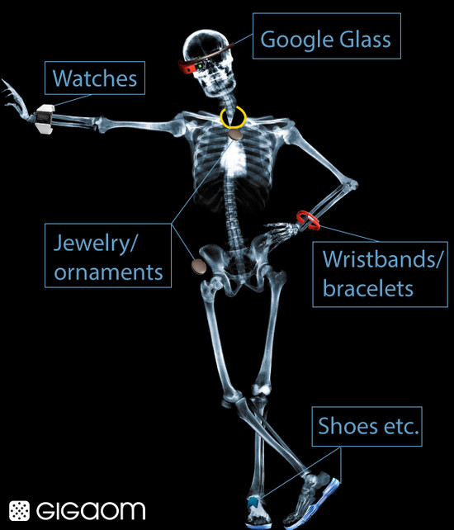
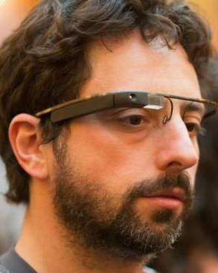
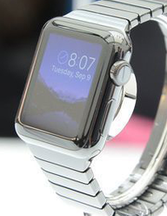
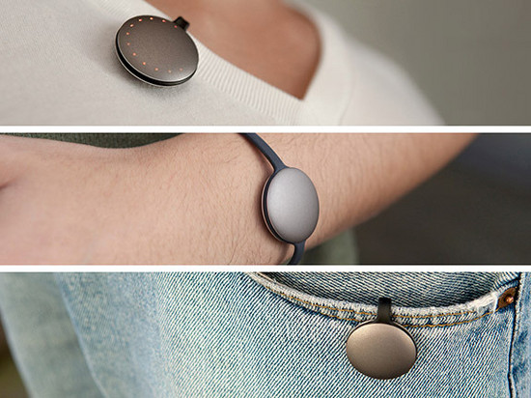
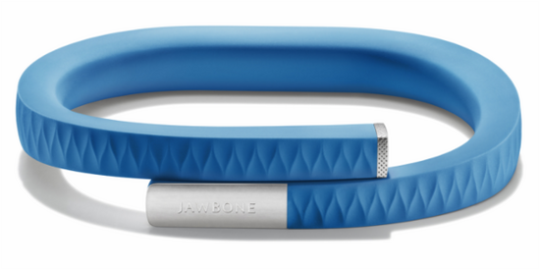
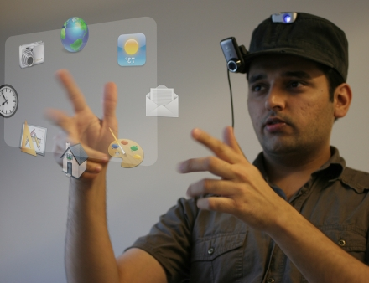
Wearable Computers
Notes:
https://www.media.mit.edu/wearables/mithril/photos.html
MIThril is a next-generation wearables research platform developed by researchers at the MIT Media Lab. The goal of the MIThril project is the development and prototyping of new techniques of human-computer interaction for body-worn applications. Through the application of human factors, machine learning, hardware engineering, and software engineering, the MIThril team is constructing a new kind of computing environment and developing prototype applications for health, communications, and just-in-time information delivery.
The SixthSense technology contains a pocket projector, a mirror and a camera contained in a head-mounted, handheld or pendant-like, wearable device. Both the projector and the camera are connected to a mobile computing device in the user’s pocket. The projector projects visual information enabling surfaces, walls and physical objects around us to be used as interfaces; while the camera recognizes and tracks users' hand gestures and physical objects using computer-vision based techniques. The software program processes the video stream data captured by the camera and tracks the locations of the colored markers (visual tracking fiducials) at the tips of the user’s fingers. The movements and arrangements of these fiducials are interpreted into gestures that act as interaction instructions for the projected application interfaces. SixthSense supports multi-touch and multi-user interaction.
Conflicting requirements
Tailoring interfaces appropriate to the device.
Offering a familiar interface so that users can quickly adapt to the new device.
http://www.tuicool.com/articles/AR7BBf

Slide 33
Recognition-based User Interfaces
Current user interface mainly uses keyboard and mouse for input.
Recognition-based user interface will become more and more important
Speech input and output
Handwriting
Gestures

Slide 34
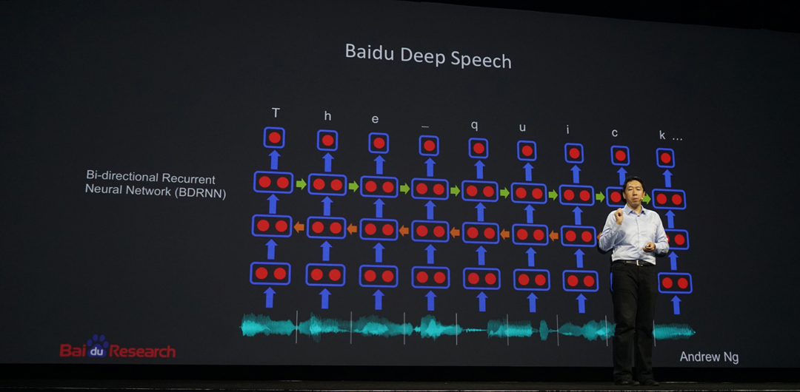
Example: Speech Recognition
Notes:
The PC sound card converts analog waves spoken into the micrcophone into a digital format. The software acoustic model breaks the word into three phonemes: ST UH FF. The software language model compares the phonemes to words in its built-in dictionary. The software decides what it thinks the spoken word was and display the best match on the screen.
http://www1.icsi.berkeley.edu/Speech/faq/SRapproaches.html
application: 语音拨号（voice dialing）speech-to-text processing (e.g., word processors or emails)

Slide 35
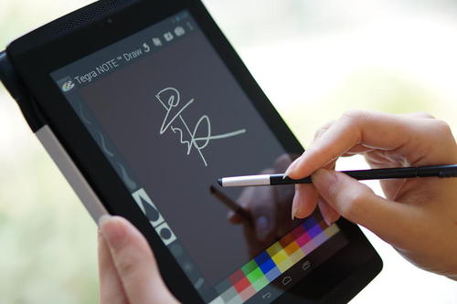
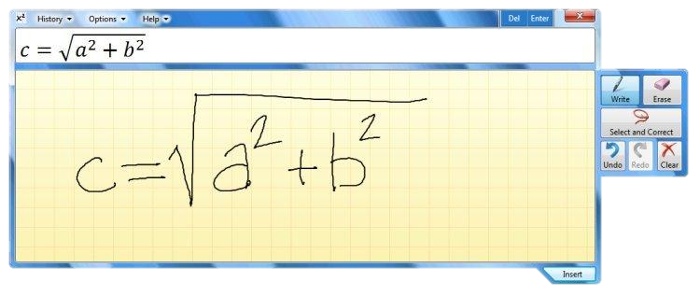
Example: Handwriting

Slide 36
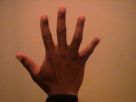

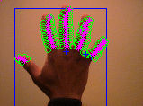
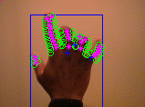
Example: Gesture Recognition
Notes:
https://www.youtube.com/watch?v=Rmh-mZFxWns
https://www.youtube.com/watch?v=sEGY6MyPqsY
http://tangible.media.mit.edu/project/indepth/
https://www.youtube.com/watch?v=hgTSQkoRUwU

Slide 37
Recognition-based User Interface
Fundamental differences from today’s interfaces
Sophisticated pattern recognition techniques are involved in the interface design.
Interface with feedback facilities are required due to recognition error.
Notes:
https://www.media.mit.edu/projects/OLD_cityhome2/overview/

Slide 38
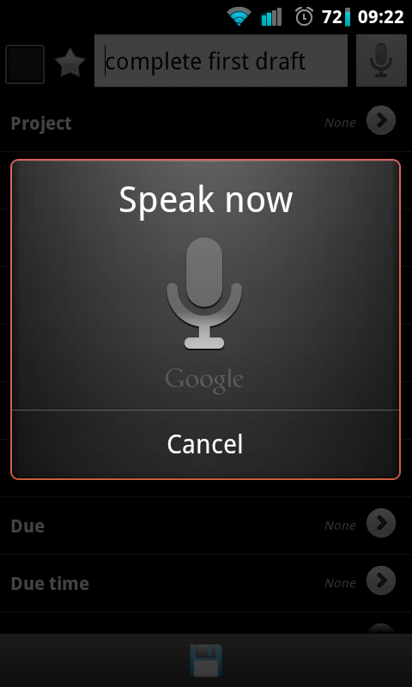
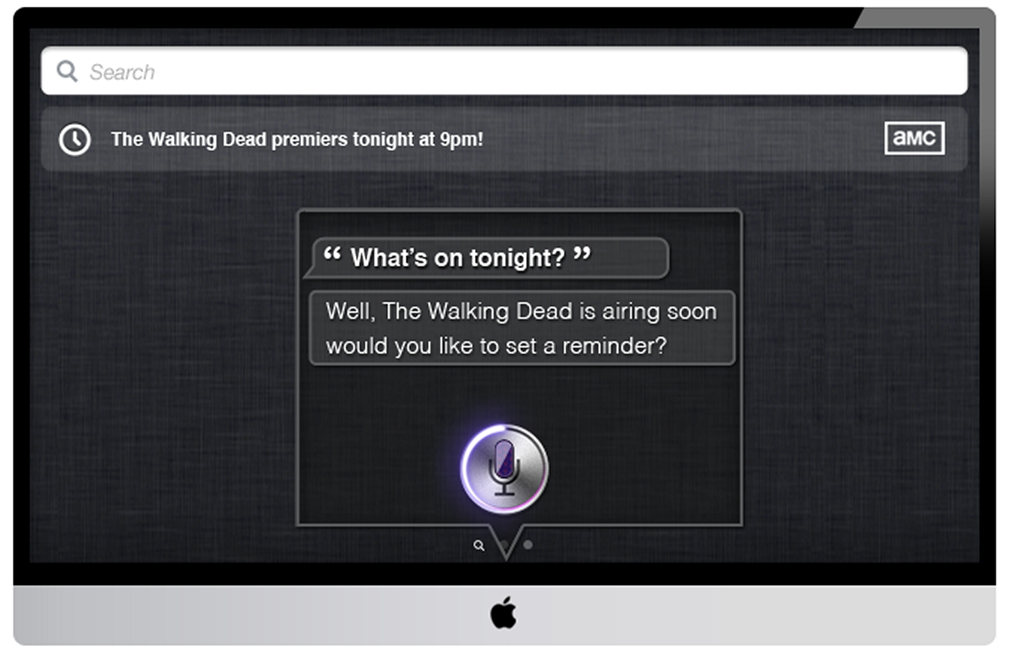
Conversational Interface
Interfaces which can respond intelligently to human conversations.
An example of a conversational interface.
Notes:
https://www.youtube.com/watch?v=ogfYd705cRs

Slide 39
Complete System
Speech recognition
Conversion of sound waves to discrete words.
Natural language understanding
Understand the meaning of the words.
Natural language generation
Generate appropriate responses.
Speech synthesis
Generation of natural-sounding speech.

Slide 40
3-D Technologies
Migration from 2-D presentation space to 3-D space.
Applications areas that benefit from 3-D technologies
Training
Simulation
Interactive exploration of complex data environments.

Slide 41
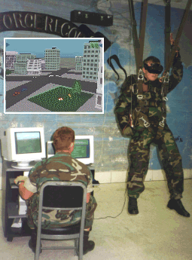
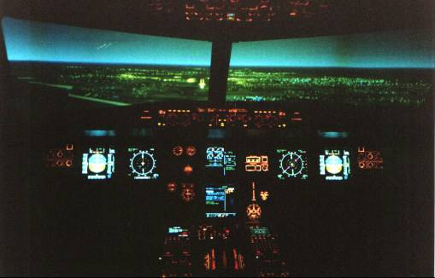
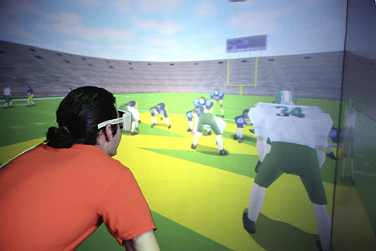
Examples
Football Training
Flight Simulator
Parachute Training
Notes:
最常见的例子就是3D图形游戏

Slide 42
3-D Technologies (cont’d)
Previous 2-D notions need to be revised
How to interact with information ?
How to select objects in 3-D space ?
How to navigate through information spaces ?
Objective: “near-real-time” interactivity to achieve the effect of direct manipulation

Slide 43
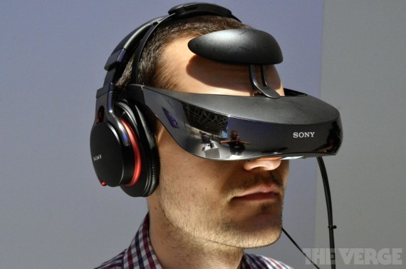
Virtual Reality
Head-Mounted Display
Notes:
Military, police and firefighters use HMDs to display tactical information such as maps or thermal imaging data while viewing the real scene.
https://www.bilibili.com/video/BV1ci4y1L7PQ?from=search&seid=17570064518957577794

Slide 44
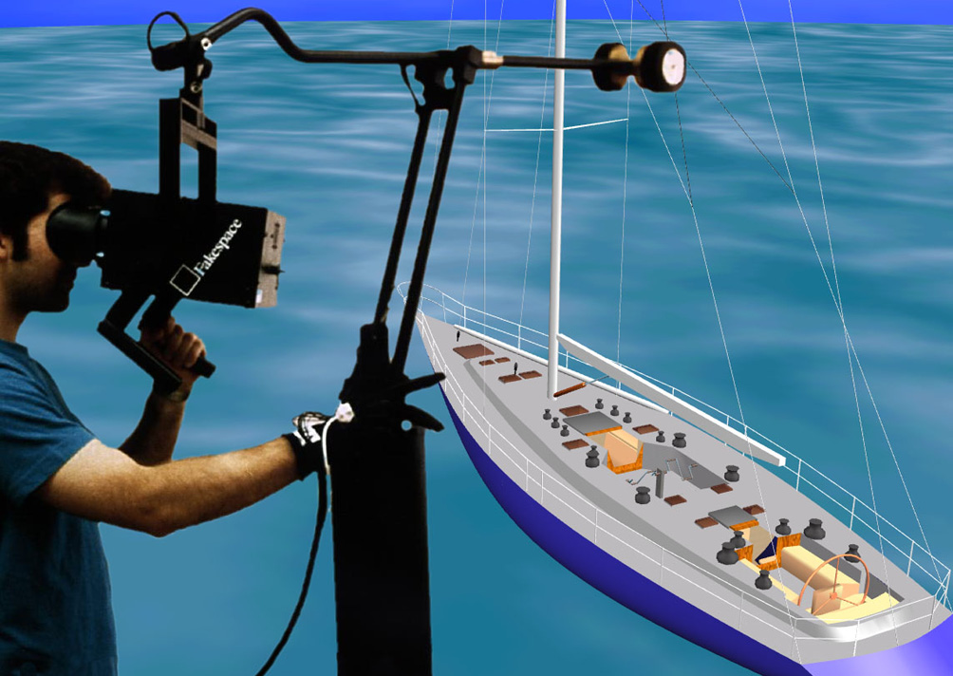
Binocular Omni-Orientation Monitor (BOOM)
Notes:
Binocular：双目
Omni-Orientation ：全方位
The Binocular Omni Orientation Monitor or BOOM is one of the oldest VR displays, and direct ancestor to the HMD.

Slide 45
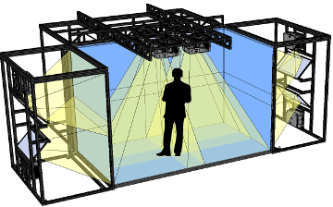
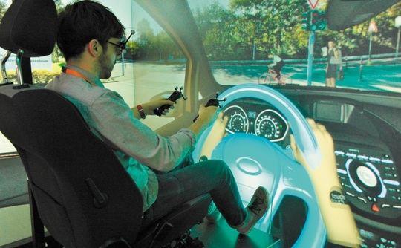
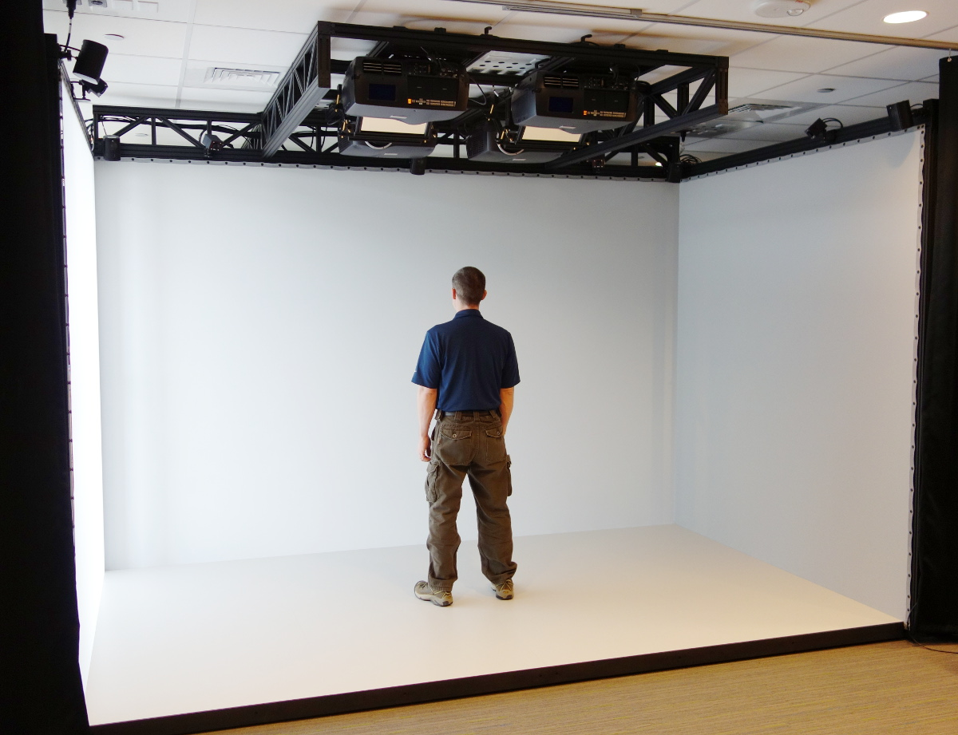
Cave Automatic Virtual Environment (CAVE)
Notes:
developed at U of Illinois, Chicago
projects stereo images onto walls and floor of a room-sized cube
users wear lightweight stereo glasses & can move freely
several users can be in same room
headtracker adjusts display to "lead user"
Ford shows off its 3D Cave automatic virtual environment
http://www.theinquirer.net/inquirer/feature/2268800/ford-shows-off-its-3d-cave-automatic-virtual-environment
https://www.youtube.com/watch?v=ukwrnnsnV9M

Slide 46
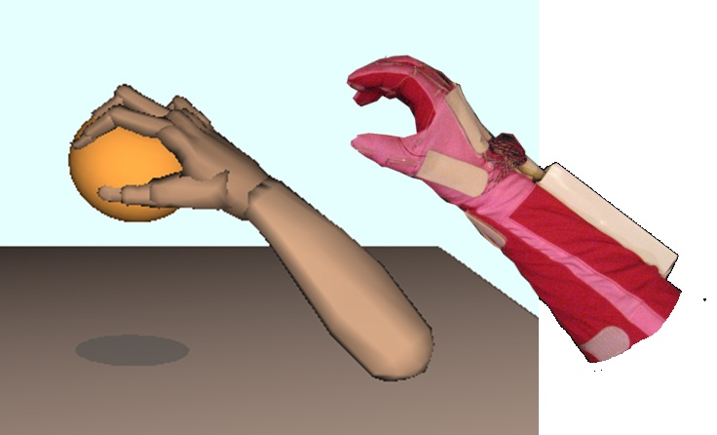
Data Glove
Notes:
https://www.youtube.com/watch?v=-b9UNLNkYFY
https://www.youtube.com/watch?v=PIhmBszYHOU
game glove: https://www.youtube.com/watch?v=W9wWnI5pnpo
5dt data glove 5 ultra 1w
https://www.bilibili.com/video/BV1ep4y1H7jm?from=search&seid=16096586837185015569
https://www.bilibili.com/video/BV1JV411i7vW?from=search&seid=16096586837185015569

Slide 47
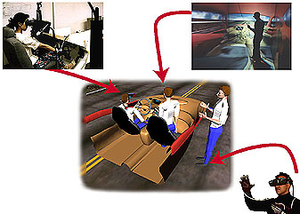
Collaborative virtual environment
Notes:
A collaborative virtual environment is a space in which several people interact with each other, often over several locations. The aim is for these people to share ideas and experiences in a co-operative setting - hence the name.
Marketing: consumer interaction
Training in dangerous/harmful situations
Social entertainment, e.g. multi-player games
Medicine: surgery simulation
Healthcare: virtual reality in phobia treatment

Slide 48
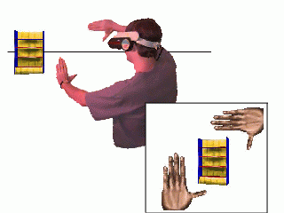
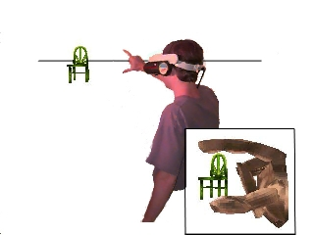
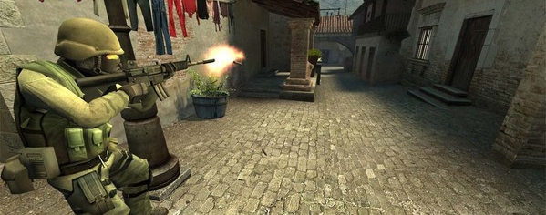
Selecting Objects in 3-D Space
Notes:
https://www.youtube.com/watch?v=chHI30_stQg

Slide 49
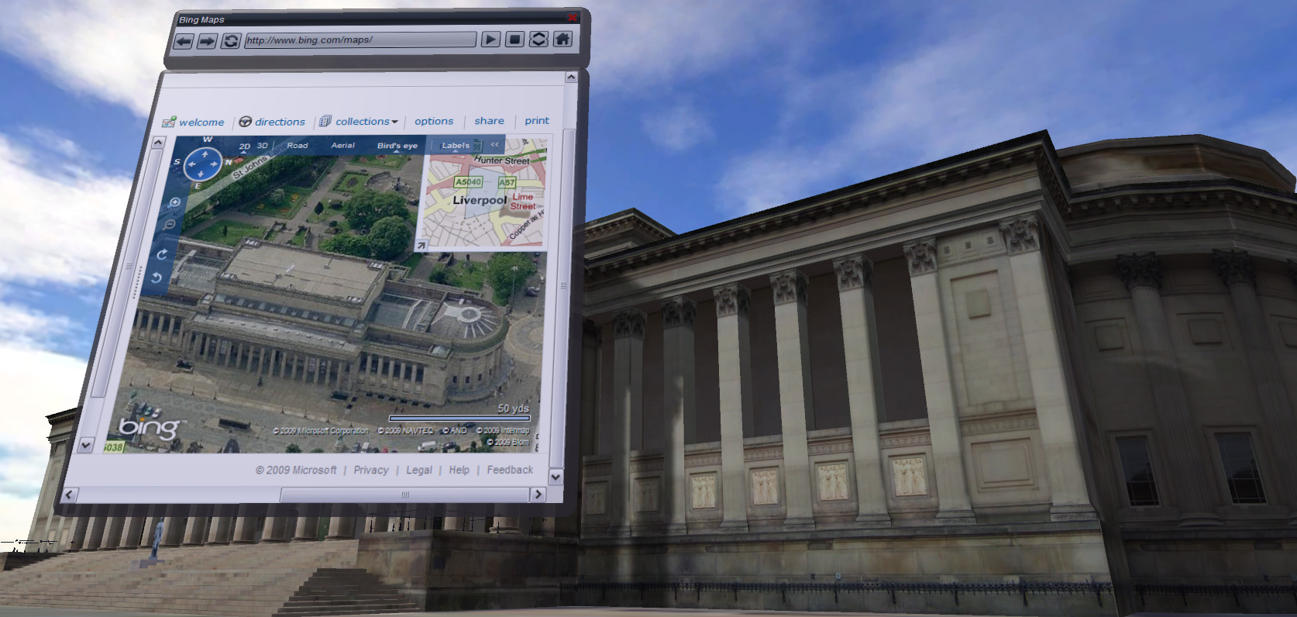
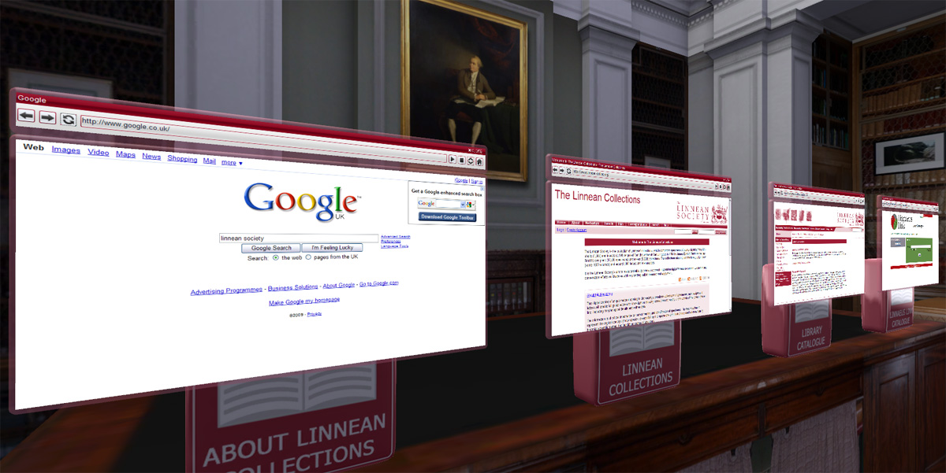
Browser in 3-D space
Notes:
https://www.youtube.com/watch?v=ni3G1r0Myj4

Slide 50



Augmented Reality

Slide 51


Augmented Reality

